Slide 1
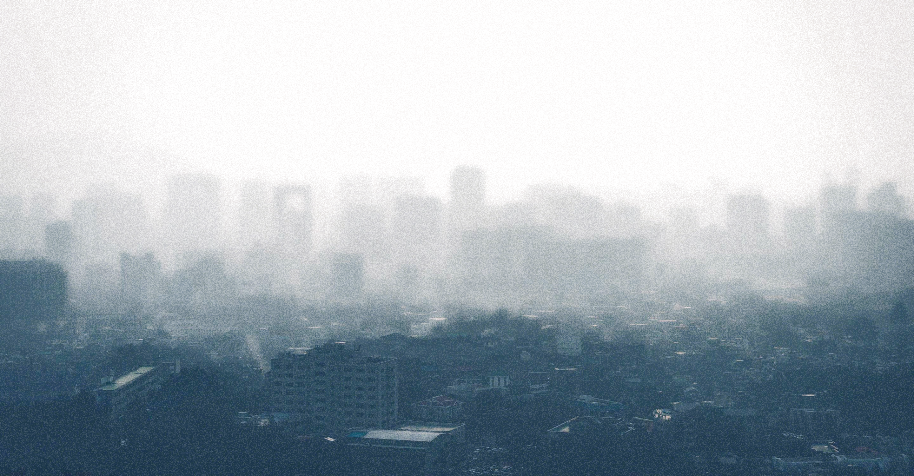
Ambient Particulate Matter
Mortality Rates from Ambient Particulate Matter in Southeast Asia
Presented to you by
Mandy Si Yi LEE
Fiona TEO
Group 2
Notes:
Hi everyone, we’re from group 2 and im veronica. Our topic today is Mortality Rates from Ambient Particulate Matter in Southeast Asia

Slide 2

Problem statement
health impact of PM2.5 in SEA, particularly on its mortality rate
Notes:
The problem we are addressing is the health impact or PM2.5 in southeast asia region, particularly on its mortality rate. This problem originates from industrial emissions, forest fire and even from the car smoke, which could lead us to long-term health impact, even death.

Slide 3

Background
outdoor air pollution caused around 650,000 deaths in Southeast Asia, with PM2.5 being the primary contributor
-WHO(2019)
Notes:
According to World Health Organization, WHO, about six hundred fifty thousands of deaths majorly caused by PM2.5 in Southeast asia during 2019. This is an issue not only limit to environment, but the public’s health too.

Slide 4
YOU
the general public
is our target audience
Notes:
YOU, the general public is our target audience.

Slide 5
Key questions
What is the correlation between air pollution levels and mortality rates across Southeast Asian countries from 1990 to 2019?
How do air quality standards and regional policies affect public health outcomes?
Which countries in Southeast Asia face the greatest public health risks from air pollution, and which populations are most vulnerable?
Notes:
These are our key questions, which would be answered later.

Slide 6
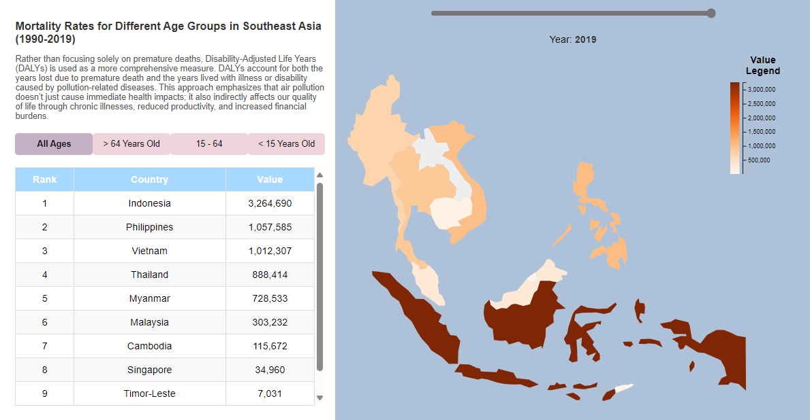
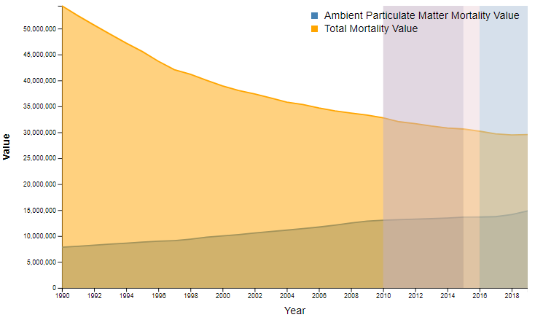
Overview of Visualisation
Choropleth
Line Chart
Notes:
We have 2 main visualisations. First is

Slide 7
Overview of Visualisation
Choropleth
Notes:
First is choropleth. It uses varying shades of color to show the intensity of mortality rates across countries. What’s more exciting is that you could adjust timeline sliders and hover over the countries to get the exact figure. There is a legend here for the user to estimate the rate clearly based on the colour code.

Slide 8
Overview of Visualisation
Choropleth
Notes:
And guess what? We also include an info panel and You can also click on the age group you want to check, and the map will change between datasets. Ranking table on countries from the most mortality rate to the least is also given.
Now I shall pass my time to mandy

Slide 9
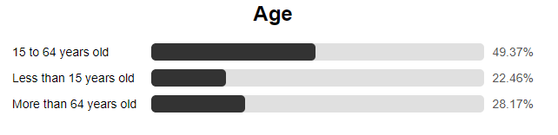
Overview of Visualisation
Choropleth
Notes:
we also included a bar chart to visualize the difference of mortality rate for the age groups to show the contrast.

Slide 10
Overview of Visualisation
Choropleth
Line Chart
Notes:
In addition to the choropleth, we used a line chart to show the trend of mortality rates from general factors and only ambient particulate matter in Southeast Asia from 1990 to 2019. In Malaysia, we not only have the rainy and hot seasons, but also the annual haze season, which was particularly severe in 2013. Since then, ASEAN and regional governments have implemented policies to tackle air pollution. The color differnce on the graph represent when these policies were introduced.

Slide 11
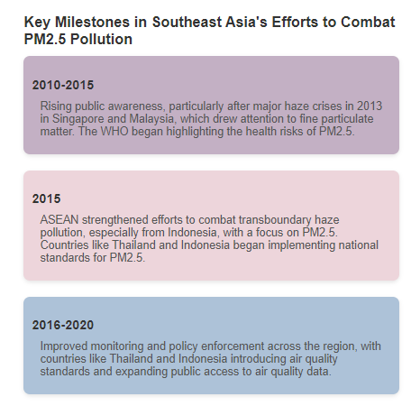
Overview of Visualisation
Line Chart
Notes:
We also added colour code to show the key milestone in SEA to show when was the awareness to this issue rose, policies implemented and enforced.

Slide 12
Key questions
What is the correlation between air pollution levels and mortality rates across Southeast Asian countries from 1990 to 2019?
How do air quality standards and regional policies affect public health outcomes?
Which countries in Southeast Asia face the greatest public health risks from air pollution, and which populations are most vulnerable?
Notes:
These are our key questions, which would be answered later.

Slide 13

Key questions
What is the correlation between air pollution levels and mortality rates across Southeast Asian countries from 1990 to 2019?
They have a positive correlation, meaning higher pollution leads to higher mortality.
Notes:
The problem we are addressing is the health impact or PM2.5 in southeast asia region, particularly on its mortality rate. This problem originates from industrial emissions, forest fire and even from the car smoke, which could lead us to long-term health impact, even death.

Slide 14

Key questions
How do air quality standards and regional policies affect public health outcomes?
Despite air quality policies, mortality rates continue to rise, indicating insufficient enforcement.
Notes:
According to World Health Organization, WHO, about six hundred fifty thousands of deaths majorly caused by PM2.5 in Southeast asia during 2019. This is an issue not only limit to environment, but the public’s health too.

Slide 15

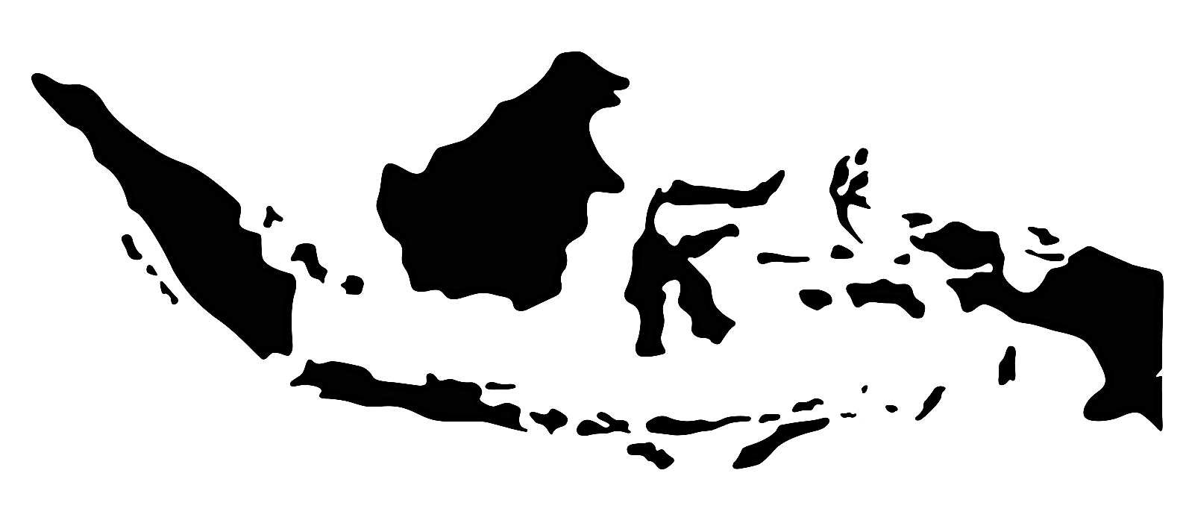
Key questions
Which countries in Southeast Asia face the greatest public health risks from air pollution,
and which populations are most vulnerable?
18-64
Indonesia faces the greatest public health risks,
15-64 years old group accounts for 49.37% of mortality from PM
Notes:
The problem we are addressing is the health impact or PM2.5 in southeast asia region, particularly on its mortality rate. This problem originates from industrial emissions, forest fire and even from the car smoke, which could lead us to long-term health impact, even death.

Slide 16
The rising mortality rates linked to air pollution in Southeast Asia underscore the urgent need for stronger, more effective air quality policies and enforcement.
Our main target audience, including people of all age group, especially 15-64 are part of the vulnerable population
Conclusion

